Slide 1
Family Center
HRGN Annual Meeting 2023

Slide 2
This is supported by the Health Resources and Services Administration (HRSA) of the U.S. Department of Health and Human Services (HHS) as part of an award totaling $400,000 with 0 percent financed with nongovernmental sources. The contents are those of the author(s) and do not necessarily represent the official views of, nor an endorsement, by HRSA, HHS, or the U.S. Government. For more information, please visit HRSA.gov.

Slide 3
Program Aims
Provide culturally- and linguistically-appropriate education and resources on genetics and genetic conditions to families
Provide technical assistance to RGNs on how best to incorporate family leaders into their programs and reach underserved populations
Train individuals and families to become family leaders within the genetic health care delivery system and the Regional Genetics Networks (RGNs)
Provide support for individuals and families with, or at risk for, genetic conditions so that they can be equal partners in their health care
Notes:
The purpose of this program is to increase access to genetic services by promoting and strengthening engagement of individuals and families with, or at risk for, genetic conditions in the genetic health care delivery system.

Slide 4
Our Partners

Slide 5
Family Center Resources
Website
Webinars
Leadership Trainings
Podcast
Peer Learning

Slide 7
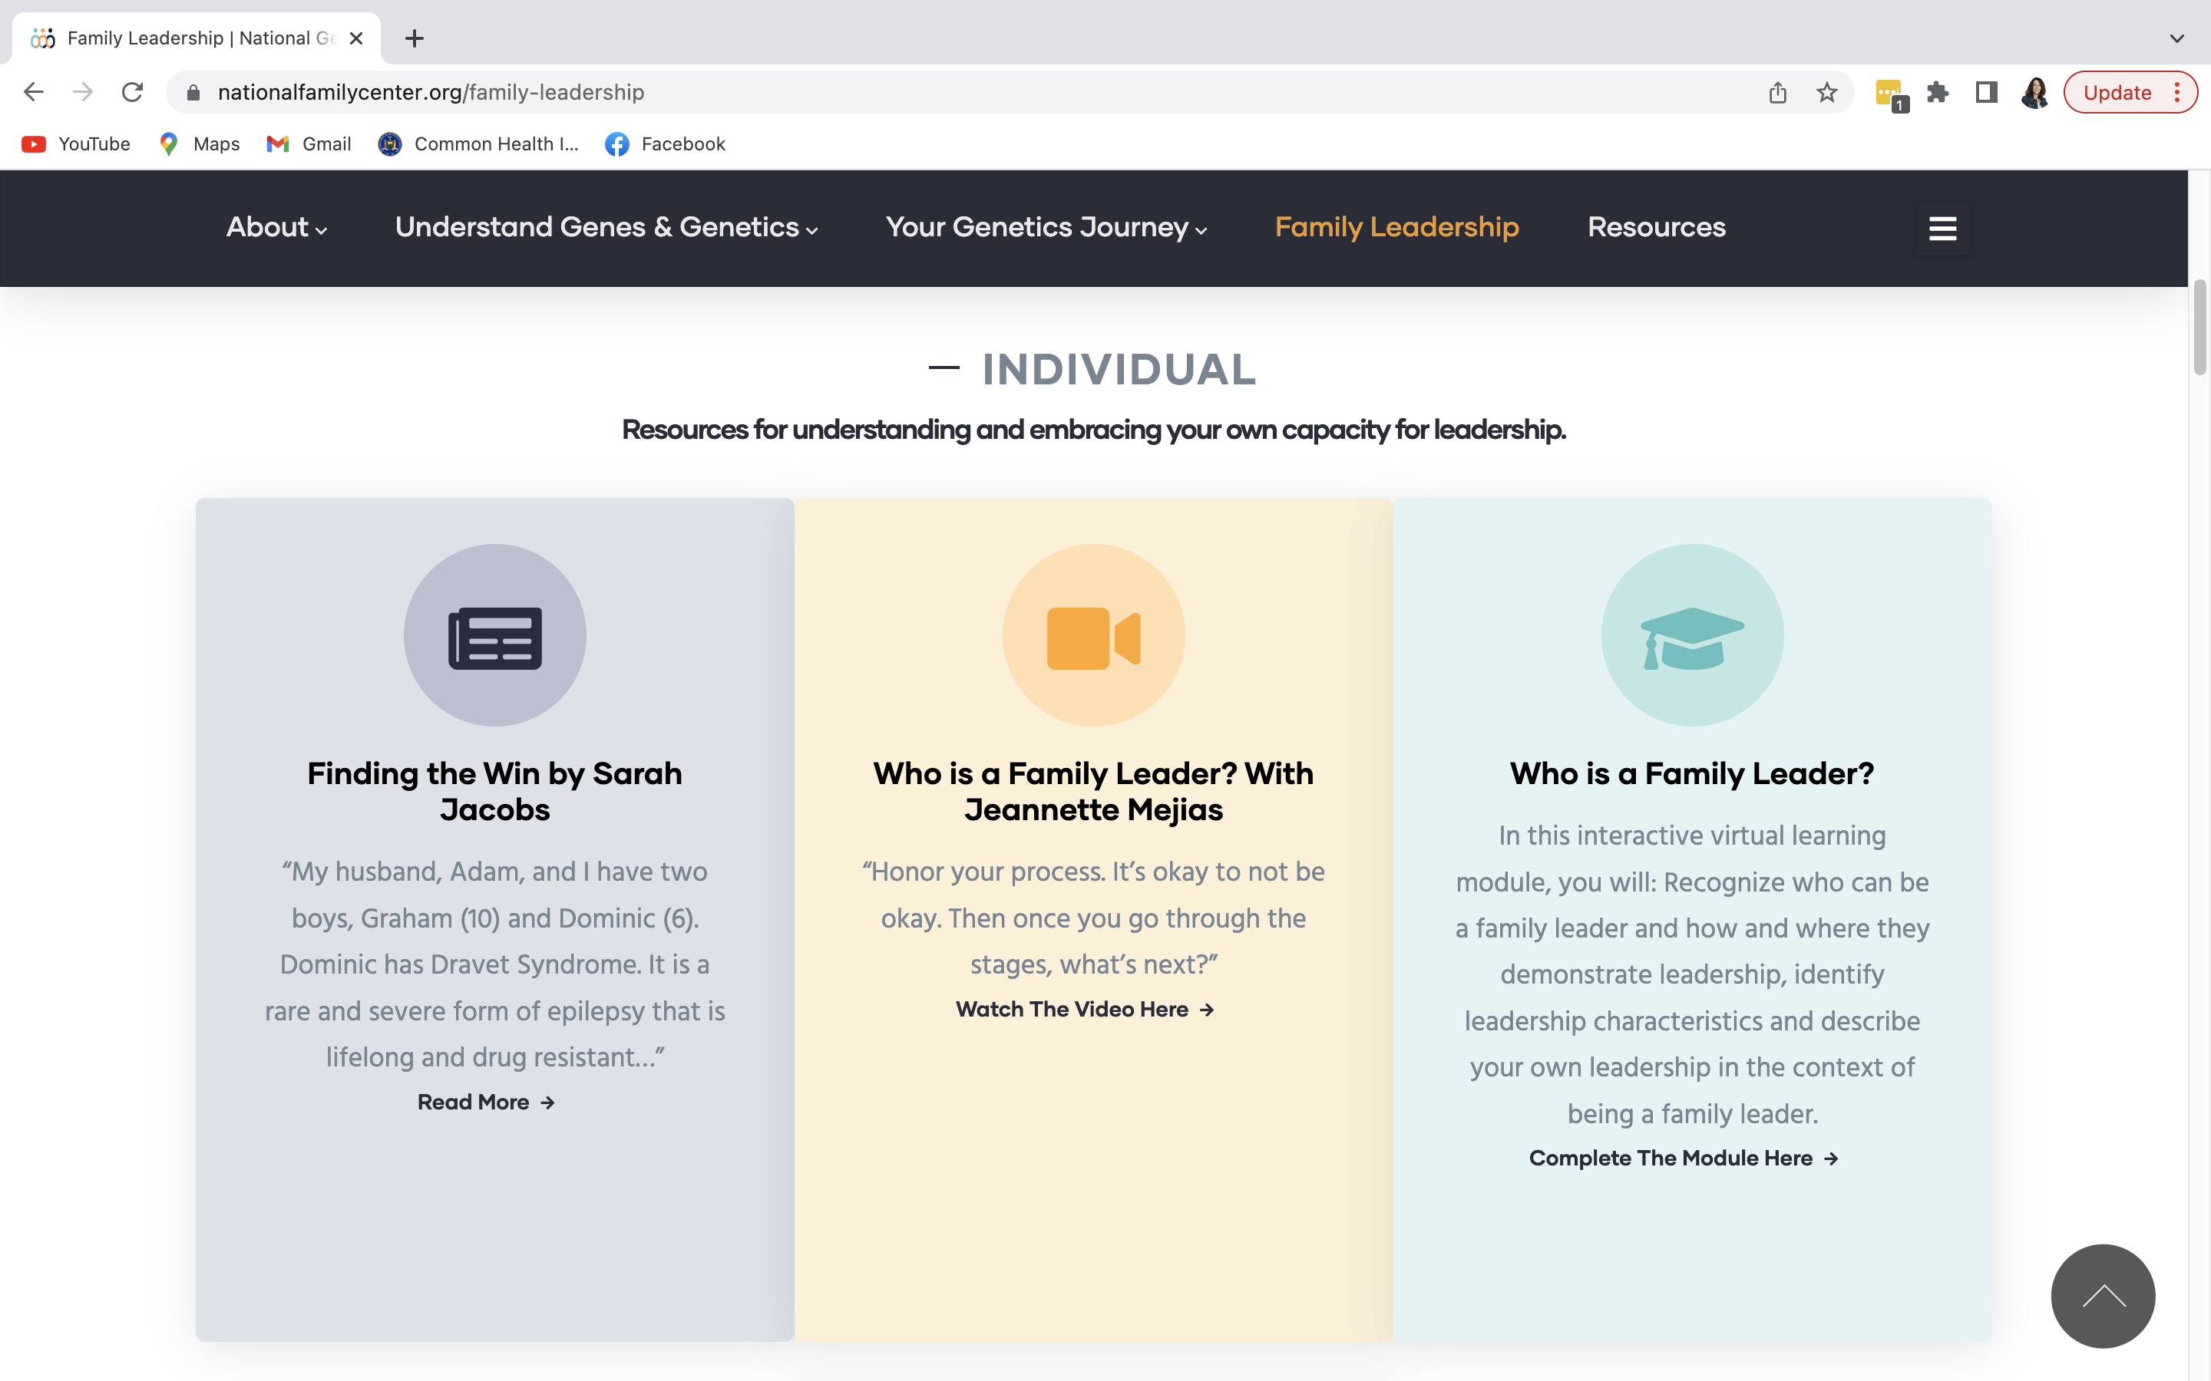

Slide 10
Peer-to-Peer Groups and Learning
Family Center Workgroup on Inclusion
Family Center Community of Practice on Diversity, Equity, and Inclusion
Parent Leader Office Hours

Slide 11
Opportunities for Involvement
Inform
Stay up to date on the latest events, resources, and trainings by signing-up for updates or follow organizations on social media.
Join
Join the Family Center Community of Practice on Diversity, Equity, and Inclusion. –
4:00 – 5:00pm EST On the third Wednesday of every other month
Reach out
Reach out at mmartzke@expectinghealth.org

Slide 12
Stay Connected
Molly Martzke
Senior Program Manager
mmartzke@expectinghealth.org
Follow Us
Follow Us
www.nationalfamilycenter.org
@NationalFamilyCenter
@NGEFSC
@NationalFamilyCenter

