Slide 1
Phase 1: Utility of educating the Hispanic and Latino population about genetics services using culturally targeted videos Phase 2: Exploring the viewers’ perspectives, attitudes, and actions taken post-video

Slide 2
Literature review
(ACGC, 2019; Herman et al., 2020; Hurtado-de-Mendoza et al.. 2019)
Genetic services can improve health outcomes.
Underserved populations may not have the same awareness, accessibility, and/or knowledge.
A role of GCs is to educate to guide informed decision-making across all populations.
Increase in alternative service delivery supports need for digital educational tools.
Notes:
Benefits can include:
- dx, management, recurrence risk
Hispanic and Latinx population is one of fastest growing, and Spanish is second most spoken language in U.S. (U.S. Census Bureau, 2019).

Slide 3
Sharing Health Information
Approximately 41% of Hispanic adults measure equal to or below basic health literacy
Available resources → eager to share
Not knowledgeable enough on the topic
(Hurtado-de-Mendoza et al., 2020; National Assessment of Adult Literacy, 2003; Page et al., 2020)
Notes:
A component of health literacy is knowing when and with whom you should share health information and how it can effect them
With more precision medicine being used the importance of having health and genetic literacy is important

Slide 4
Educational videos
Introduces team members
Presents common referral reasons
Prepares family on what-to-expect at a Pediatric Genetics clinic
Video title: What is a genetics clinic?
https://www.heartlandcollaborative.org/for-families/resources/.
Notes:
Video production involved:
Team of: genetic counselors, geneticists, etc.. (Ask Mary Ann to help with this)
3 rounds of script production, edits, …
Animation added …
Introduces team members
Geneticist
GC
Interpreter
Presents common referral reasons
Physical differences
Attention difficulties
Prepares family on what-to-expect at a Pediatric Genetics clinic
Length of appt
Access to interpreters
Labs/physical exam

Slide 5
Educational videos (cont.)
Describes roles
Defines genetic terminology
Presents common causes of genetic conditions
Video title: What are chromosomes and genes?
https://www.heartlandcollaborative.org/for-families/resources/.
Notes:
Describes roles
GC takes history and consents for genetic tests
Defines genetic terminology
cells
Chromosomes
Genes
DNA
Presents common causes of genetic conditions
De novo
Inherited

Slide 6
Study Goals and Aims

Slide 7
Research goal
Evaluate the effectiveness of two Spanish narrative educational videos
If effective, this could change preparation process for a GC session to help with understanding and facilitating questions during the session.
Notes:
Evaluate the effectiveness of two Spanish narrative educational videos on increasing awareness and knowledge in Hispanic and Latinx populations regarding genetic services and the application of genomic medicine.
Change the way we prepare non-English speakers for their appt
Utilize same language resources
Utilize culturally appropriate educational tools
Supports GC role of providing both education and psychosocial counseling

Slide 8
Phase 1: Aims
We hypothesize that, for Spanish-speaking populations, these videos will:
Aim #1 Increase awareness of genetic services
Aim #2 Increase knowledge of genetic concepts in all participants
Aim #3 Influence perceptions of the utility of health communication
Notes:
For health communication – we could have further explored if the videos changed likelihood of talking to their health care provider about the health conditions in their family.
b) Increase knowledge regardless of education level, health literacy level and previous experience with a genetics provider, and

Slide 9
Phase 2: Aims
Examine the participants’ specific feedback of the culturally targeted videos.
Explore how the culturally targeted videos affected the participants’ perspectives, attitudes, or beliefs about genetics services.
Describe the changes participants made to how they communicate personal health information and with whom they communicate --family, friends, and/or healthcare professionals.
Determine the future needs, the preferred language, and what topics the participants would like covered in educational resources.

Slide 10
Methods Overview

Slide 11
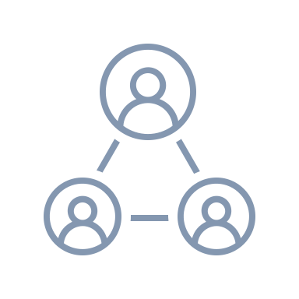
Phase 1
Quantitative
Pre-post survey
Baseline survey: 10-15 min
Videos: (~10 min)
5-min break + distractor video
Health communication questions
Post-survey: 10-15 min
Modality: Zoom or in-person
REDCap survey
$40 Walmart gift card
SCs compensated
Notes:
- Participants had option to leave video off
- Not video recorded

Slide 12
Phase 2 - Qualitative Semi-structured Interviews

Slide 13
Phase 1 Results

Slide 14
Sociodemographic characteristics
Sociodemographic Characteristics
 | M | SD
Age | 38.31 | 11.9
 | N | %
Genderª
Female | 98 | 74.8
Male | 33 | 25.2
Education Level
Elementary | 5 | 3.8
Middle school | 13 | 9.9
High school | 46 | 35.1
College | 45 | 34.4
Graduate | 22 | 16.8
Previous Experience with Genetic Services
Yes | 33 | 25.2
No | 98 | 74.8
Notes:
Table 1
Descriptive statistics
Gender response option was fill in the blank. So male and female were the only 2 response options we received from participants.
videos written at middle school level
Table 1
Descriptive statistics
Other languages: English, K’iche’, German, French, Portuguese, and American Sign Language.
25.2% of participants reported previous experience with genetic services, including worked in a genetics clinic, personally saw a genetic specialist, or had a family member who had a genetic appointment, attended a talk about genetics, and did Ancestry DNA, a direct to consumer (DTC) genetic testing option.
Note. N =131

Slide 15
Genetic services awareness
Total score (0-5) | n | Percent %
0 | 50 | 38.2
1 | 30 | 22.9
2 | 13 | 9.9
3 | 15 | 11.5
4 | 10 | 7.6
5 | 13 | 9.9
Total | 131 | 100.0
Notes:
Table 2
Genetic Services Health Literacy All Participants Total Score
Note. This table demonstrates the total number and percentage of correct answers scored by participants regarding genetic services health literacy. N = 131.
Genetic services health literacy was stratified by knowledge score changes.
91% participants had some lack of knowledge of how to access genetic services / services available to them

Slide 16
Genetic knowledge scores
Total score* | n (131) | Pre median (IQR) | Post median (IQR) | p-value**
All participants
Overall | 131 | 19 (15,21) | 22 (20,23) | <.001
Education
Middle school or below | 18 | 15 (6.5,19.5) | 21 (20,22.25) | <.001
High school and above | 113 | 19 (16,21) | 22 (20.5,24) | <.001
Experience
No previous experience | 98 | 19 (15.75,21) | 22 (20,23) | <.001
Any previous experience | 33 | 18 (15,20.5) | 23 (21,24) | <.001
Genetic Services Health Literacy
Low health literacy | 93 | 19 (15,21) | 22 (20,23) | <.001
High health literacy | 38 | 18.5 (15.75,21.25) | 23 (21,24) | <.001
Notes:
Table 4
Pre-post Knowledge Changes of Total Score and Stratified by Education, Previous Experience, and Genetic Services Health Literacy.
Note. N = 131. Analysis was performed by a Related Samples Wilcoxon Signed Rank Test.
* The total score ranged from 0-25.
**The significance level is p < .05.
Regardless of how we stratified participants, there were all significant knowledge gain
Median was used instead of mean because requirements for the nonparametric tests were not met.
Elementary school = common, 6th grade = average

Slide 17
Attitudes toward health communication
 | Before videos |  | After videos: only measured those who answered ‘No’ in the before videos
Group | Yes n (%) | No n (%) | More likely n (%) | Equally as likely n (%) | Less likely n (%)
First-degree relatives | 102 (77.9%) | 29 (22.1%) | 20 (69%) | 9 (31%) | 0 (0%)
Second/third-degree relatives | 49 (37.4%) | 82 (62.6%) | 46 (56.1%) | 32 (39%) | 4 (4.9%)
Cultural community | 35 (26.7%) | 96 (73.3%) | 36 (37.5%) | 47 (49%) | 13 (13.5%)
Public health | 49 (37.4%) | 82 (62.6% | 35 (42.7%) | 35 (42.7%) | 12 (14.6%)
Notes:
Comment on participants who answered no to all (universally hesitant to health communication)

Slide 18
Changes in behavior regarding family health communications measured after video
Notes:
Note. This figure is a visual representation of changes in likelihood to discuss health information with the associated group for participants who responded that they do not communicate with that group before watching the videos.
More-likely is biggest focused – changed attitude through video. Equally as likely
Big impact for a small intervention
Increase in health communication in any way can mean a big difference in association with risk assessment and public health matters
Less-likely: not going to talk to those groups of people anyway – not lost communication. Motivation? After watching videos, could be most relevant to first-degree relatives?
Cultural community and public health – inferred, not discussed in video

Slide 19
Changes in behavior regarding health communication for participants who identified as communication hesitant
Notes:
Note. This figure is a visual representation of changes in likelihood to discuss health information with the associated group for participants who responded that they do not communicate with that group before watching the videos. N=22
If we know there’s hesitancy in a population, being explicit as GCs about the importance of health communication and how to communicate can be extremely important (increase resources, videos are easier to disseminate)

Slide 20
Phase 2 Results

Slide 23
Theme 1: High quality and impression of video content
All participants (n=13) had positive reference to the video content
92.3% (n=12) commented on the videos content being simple, understandable or having clear communication.
100% (n=11) reported that the cartoon characters were culturally appropriate, family friendly, and did not offend any beliefs or values
*2 participants were not asked the questions
I like that they are. Ah. It is so simple to understand and have a. Ah, they are compared to very basic things, which is easier to understand. I was very pleased that they did it with food, with things that we are familiar with.
Participant 69

Slide 24
Theme 2: Impact and value of videos
Utility of Videos
Video content was helpful (n=13)
Participants who have had experience with genetics services (n=8)
Videos would have been useful beforehand (n=8)
All participants responded ‘no’ when asked “Did any of the information in the videos make you feel guilty or fearful?”
Value of Videos
Had shared the video with other people (n=11)
Plan to share the video with more/other people (n=9)
Retention (n=2) - awareness of where to look and where to find the information
2 participants commented about returning to the videos to use again
Yes, yes, because at the time of the appointment, well it was a lot of information and at that moment it was like it went away. And yesterday when I watched it again, That's when I said oh yes this is what I was told and so I shared it all with my husband
Participant 139
The videos had a perfect timing because we recently contacted a genetic studies clinic, and they are very much in line with reality
Participant 36

Slide 25
Theme 3: Future requests based on personal experiences
Future Video Requests
Broad Health Related Topics (n=5)
Specific Conditions (n=4)
Other specific requests included Down Syndrome and autism spectrum disorder
Changes to the Videos
Amount of Information (n=2)
More information
Length (n=2)
Longer videos
Ability to utilize videos (n=2)
Accessibility of video content
Well ohhh if a deaf person were to watch the video, unless they do not know how to read ehhh and know the concepts well, they would not be able to understand it.
Participant 113

Slide 26
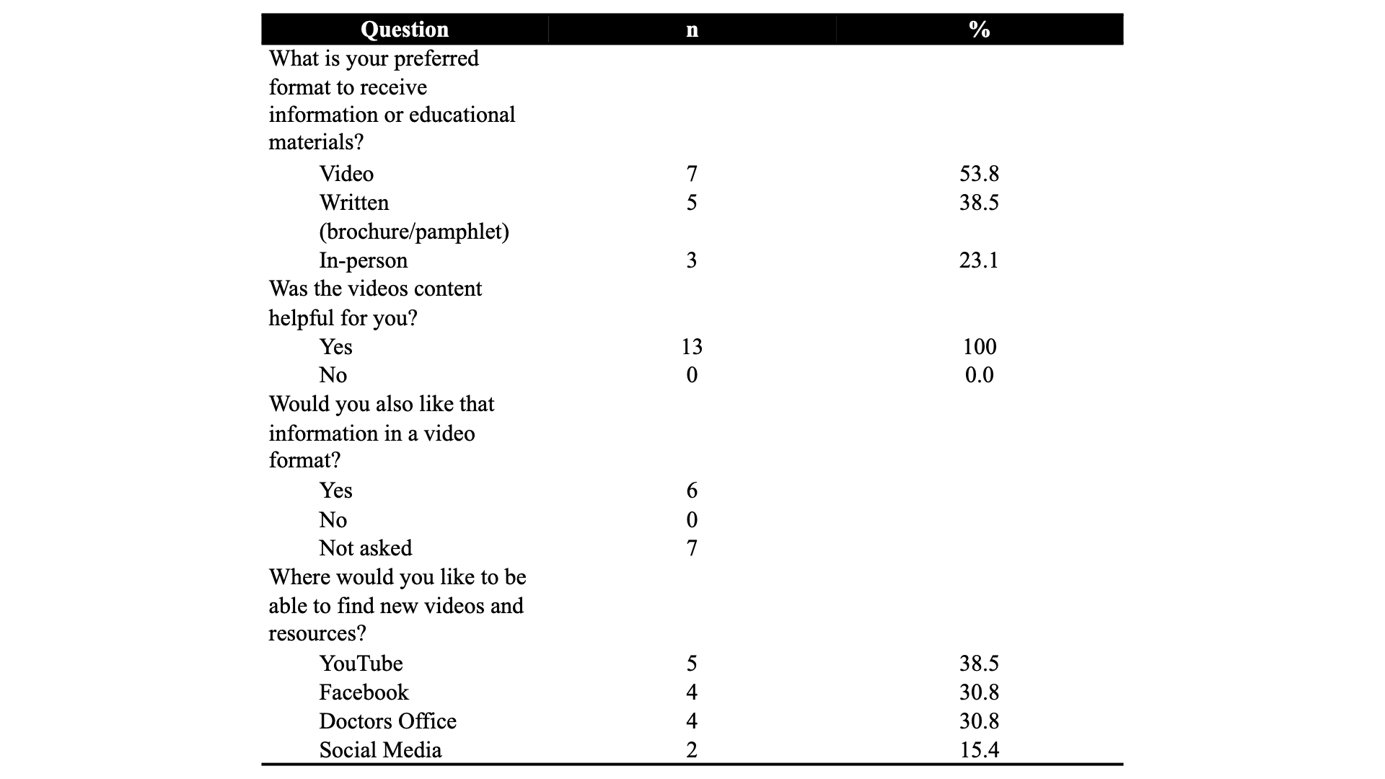

Slide 27
Theme 4: Barriers to accessing genetics services
Majority of participants did not identify any barriers to use of genetics services (n=8)
Financial Barrier (n=4)
Cost
Health Insurance
Not knowing where to find genetics services (n=3)
1 Puerto Rico
2 United States

Slide 28
Discussion

Slide 29
Phase 1 showed the videos increased the knowledge of genetics concepts → Phase 2 showed that this information is shown in a clear and understandable format
Phase 1 data showed that participants were likely to share the videos with others and this was supported in Phase 2 with the majority of participants having already shared the videos with other people
Phase 2 reinforced the idea from phase 1 that participants have the desire to have the videos in places such as the PCP office to watch prior to appointments

Slide 30
Conclusions
Videos can change prep process for pediatric GC patients
Increased understanding
More conversation/questions
Establishes trust
More effective
Educating one person still can transform a community
Peer to Peer education
Sharing video with others
Notes:
As these Spanish-narrative videos increased knowledge scores, if they were sent to patients prior to their visit with a Genetic clinic it may facilitate more questions and discussion between patient and GC and/or geneticist. Increased understanding and conversation can strengthen patients trust with their healthcare providers, but also with one’s family members and community by knowing the utility of discussing health information. Educating one person still can transform a community by raising awareness whether that be about one’s personal health concerns or about public health.

Slide 31
Future Video Recommendations
How to Navigate the U.S. Healthcare System
Inclusion of sign language in the videos → Need to learn more about dialect of sign language that will be applicable broadly

